Slide 1



SNS COLLEGE OF TECHNOLOGY AN AUTONOMOUS INSTITUTION MERN Stack Development & Entrepreneur TECSNAPIE SOLUTIONS
Done by
KARTHIKEYAN R M
20CS057

Slide 2
OBJECTIVE
The main objective of this month is to develop and improve my MERN stack development and Entrepreneurship skills which I already posses along with a learning phase. At the end of the month , I will ensure that I will gain more knowledge about MERN stack development, Entrepreneurship and its strategies.

Slide 3

COMPANY PROFILE
TECHSNAPIE SOLUTIONS– COIMBATORE
Techsnapie Solutions is one of the best Software Development company in Coimbatore. Working with clients from different sectors, they have curated the best methods to help the clients to make their business in elegant way using best technology.
The firm provides valuable training programs for students in their future domains.

Slide 4

DOMAIN FOCUSSED
The domain focussed in the Startup is
“MERN Stack Development”.
MERN stack is a collection of technologies that enables faster application development. It is used by developers worldwide. The main purpose of using MERN stack is to develop apps using JavaScript only. This is because the four technologies that make up the technology stack are all JS-based

Slide 5
TIMELINE OF THE INTERNSHIP
Total duration: 30 days
Theoretical learning: 15 days
Project learning : 15 days

Slide 6

CONTENT LEARNT
Node.JS
MongoBD
React.JS
Express.JS
React Native (Intermediate)
ADD ONs
Member in Business Community.
Hosted meeting for Business
Commodities to empower their sales and production

Slide 7
OUTCOME OF THE INTERNSHIP
Through this month, I learned about MERN Stack and how to implement its strategies in today’s digitalized world.
Brainstorming the problems make me to be in Critical Thinking.
Focusing on the future, it helps to make a right decision in critical situations.

Slide 8
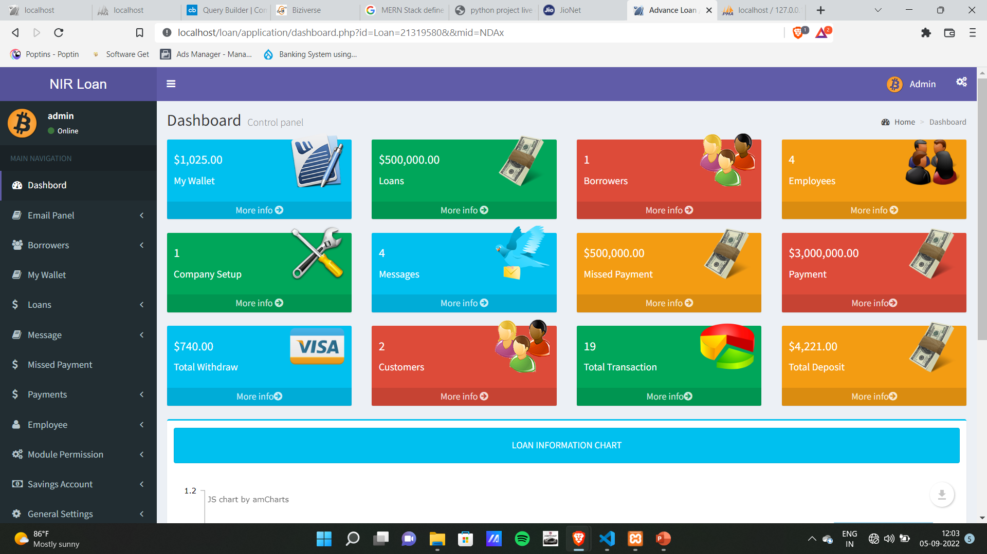
My works on the domain
Created ERP for SVAN Micro Credit Bank - Nagapattinam

Slide 9
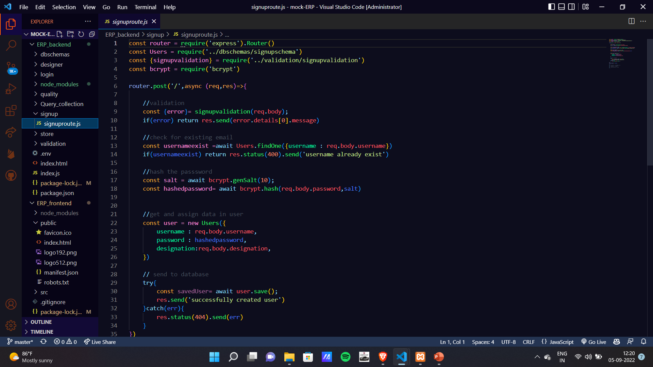
Snapshot of some of the codes

Slide 10
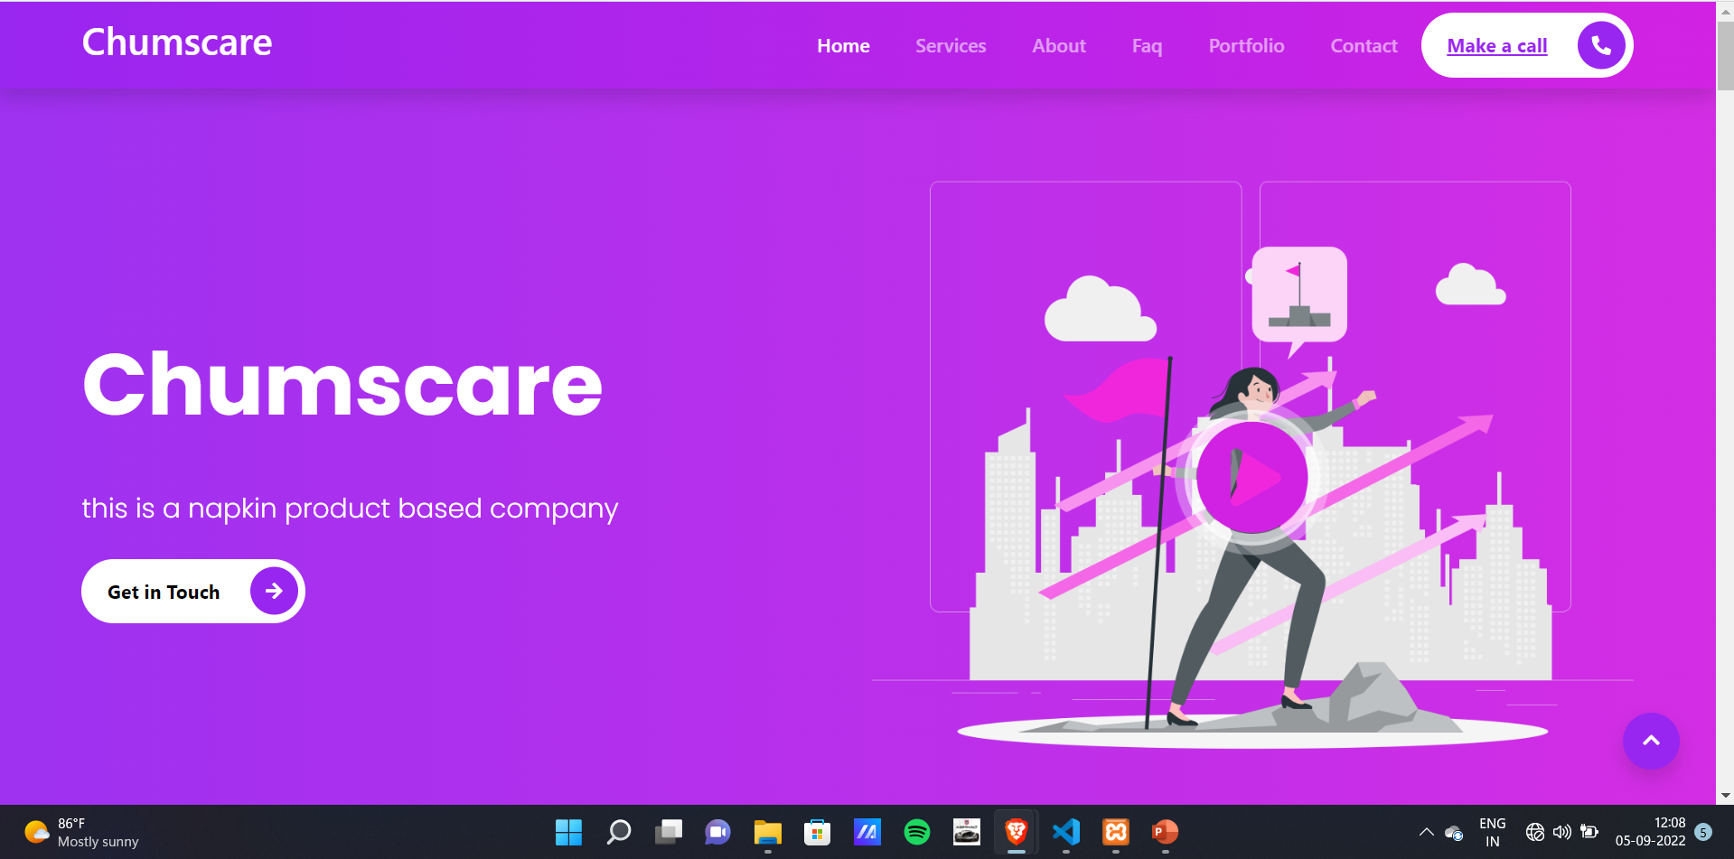
Project done in side hustle:
Chumscare – A feminine Product

Slide 11
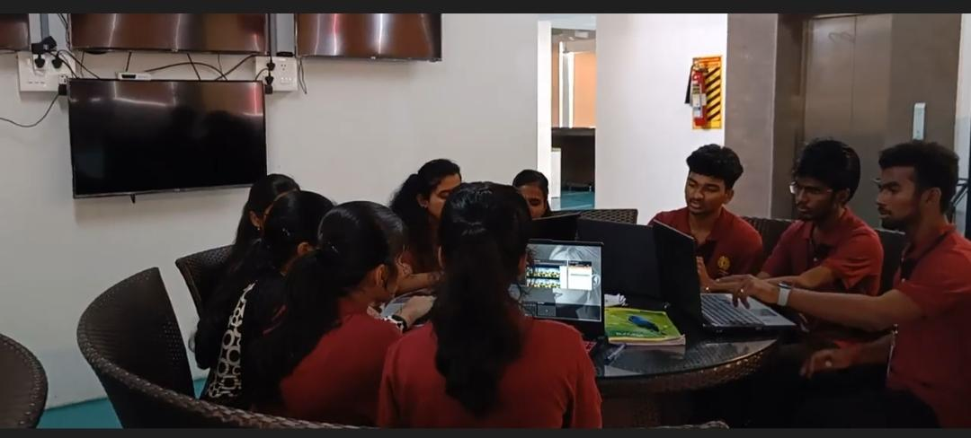
PHOTO PROOF

Slide 12


